Slide 1
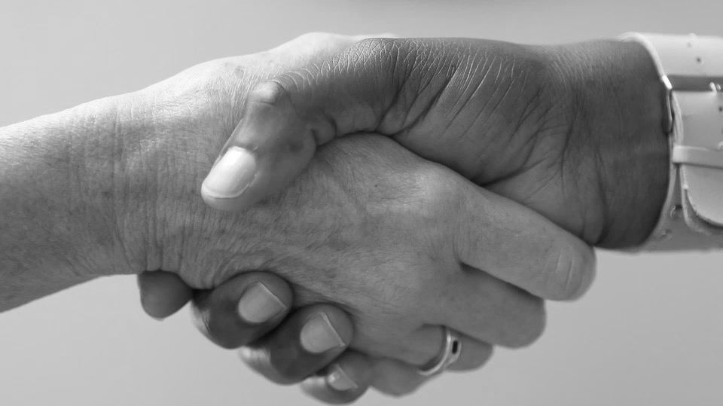
Disability and Employment Tedros Markos Tekle Immigrant and Refugee-Led Capacity Development Network of IL
Tedros Markos Tekle

Slide 2
Background
I came from a society where adverse childhood experiences and/or trauma can be least understood.
Was a radio and press journalist in Eritrea.
Spent five years in exile.
Fled Eritrea for fear of reprisal.
Came to the United States in December 2017.
2

Slide 3
My First Days in the United States
Resettlement agencies often prefer to stay oblivious to new arrivals, particularly, those with disabilities.
These same agencies do not have staff trained specifically to support refugees with disabilities.
Consumer organizations for and of people with disabilities do not run programs that can help refugees with disabilities integrate into the new society.
My work experience and educational background in my home country has been of little avail in my quest for gainful employment.
3

Slide 4
Accessibility Challenges at School
Inaccessible or partially accessible web conferencing apps.
Websites not designed with assistive technology and inclusion in mind.
Inaccessible instructional materials and examinations containing charts.
Counterintuitive web design that impedes efficiency.
4

Slide 5
Disability and Ableism Defined
World Health Organization (WHO): A disability is any condition of the body or mind (also called an impairment) that makes it more difficult for the person with the condition to do certain activities (activity limitation) and interact with the world around them (participation restrictions).
Americans with Disabilities Act: The ADA defines a person with a disability as a person who has a physical or mental impairment that substantially limits one or more major life activity.
Activity is the execution of a task or action by an individual.
Participation is a person’s involvement in a life situation.
Ableism: Discrimination in favor of the able-bodied.
5

Slide 6
The Listed Conditions May or Can be Disabling
Cancer
Diabetes
Post-traumatic stress disorder
HIV
Autism
Cerebral palsy
Deafness or hearing loss
Blindness or low vision
Epilepsy
Mobility disabilities such as those requiring the use of a wheelchair, walker, or cane
Intellectual disabilities
Major depressive disorder
Traumatic brain injury
6

Slide 7
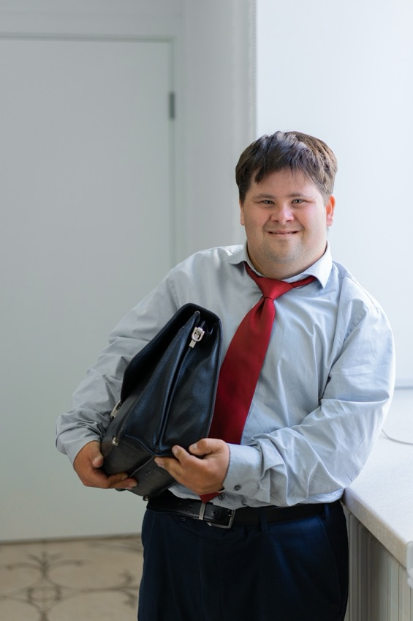
Inclusion at Work
Inclusion at work involves creating reasonable opportunities for gainful employment for people with disabilities.
Accessibility is the ability of disabled people to access and efficiently use products, devices, services, and/or environments.
Is the physical and digital environment at work equally accessible to everyone?
Are products, devices, services, and/or environments in any organization accessible to, useable and navigable by everyone?
7

Slide 8
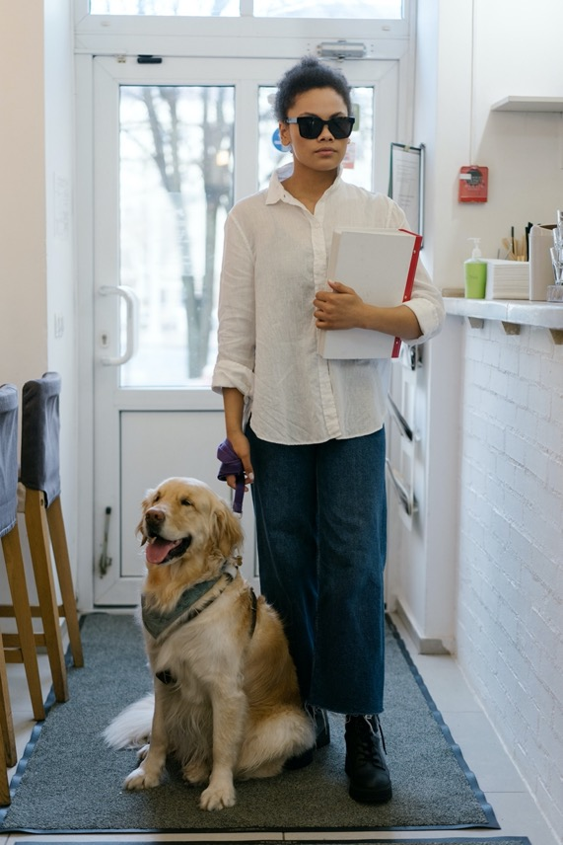
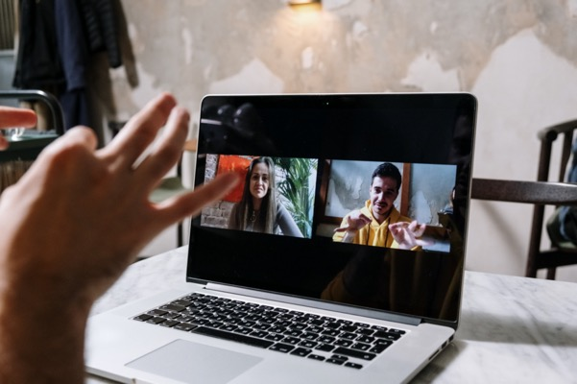
Reasonable Accommodations
No-tech
Low-tech
High-tech
8

